Slide 1
BRACHIAL PLEXUS INJURY INVESTIGATION , LOCALIZATION AND TREATMENT

Slide 2
EMBRYOLOGY
Brachial plexus (BP) is developed at 5 weeks of gestation
Afferent fibers develop from neuroblast located alongside neural tube
Efferent fibers originate from neuroblast in the basal plate of tube from where they grow outside
Afferent and efferent fibers join to form the nerve

Slide 3
Nerves divide into anterior and posterior divisions
There are connections between these nerves in the brachial plexus

Slide 4
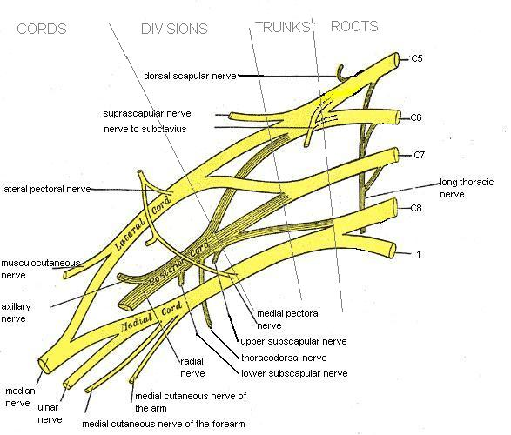
commons.wikimedia.org/wiki/File:Brachial_plexus.jpg

Slide 5
Anatomy
Formed by ventral primary rami of lower four cervical and first thoracic nerve root.
Frequently have contributions from C4(pre-fixed) or T2(post-fixed).

Slide 6
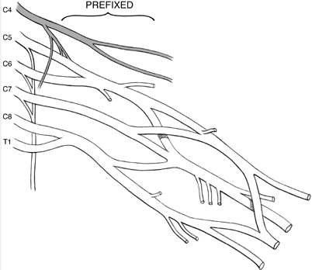
PREFIXED BRACHIAL PLEXUS
http://www.msdlatinamerica.com/ebooks/HandSurgery/sid744608.html

Slide 7
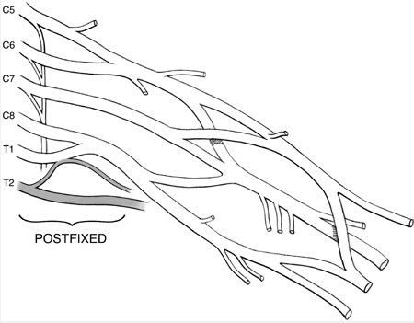
Post-fixed plexus
http://www.msdlatinamerica.com/ebooks/HandSurgery/sid744608.html

Slide 8
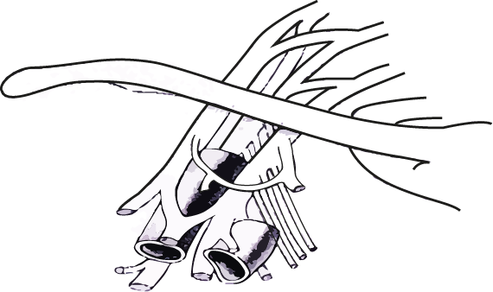
RELATIONS OF BRACHIAL PLEXUS
Fig. 4. The reIationship of the axillary artery to the cords is an important anatomic relationship. The cords surround the axiIIary artery and are named for their position with respect to the axillary artery. L.C. lateral cord MC. Medial cord: PC . posterior Cord.

Slide 9
Levels
Roots
Trunks
Divisions
Cords
Branches
Real
Texans
Drink
Cold
Beer

Slide 10
C5 and C6 roots form upper trunk
C8 and T1 roots the lower trunk
C7 forms the middle trunk
Joining point of C5-C6 roots is ERB”S POINT
Each trunk divides into an anterior and a posterior division and passes beneath the clavicle

Slide 11
All 3 posterior divisions merge to form the posterior cord
Anterior division of the upper and middle trunk merge to form the lateral cord
Anterior division of lower trunk forms the medial cord

Slide 12
Lateral cord splits into 2 terminal branches:
a) Musculocutaneous nerve b) Lateral cord contribution to median nerve (sensory)
Posterior cord splits into
a)axillary nerve and
b)radial nerve
Medial cord gives off
a) medial cord contribution to the median nerve(motor) and
b)ulnar nerve

Slide 13
There are few terminal branches of the roots trunks and cords.
ROOTS: a)dorsal scapular nerve b)branch to phrenic nerve c)Long thoracic nerve
TRUNKS: a)nerve to subclavius b) suprascapular nerve
CORDS: a) Lateral cord gives lateral pectoral nerve b)Posterior cord gives upper subscapular, lower subscapular and thoracodorsal nerve.

Slide 14
Medial cord gives medial pectoral, medial cut. nerve of arm and forearm.

Slide 15
Variations
Found in around 50%
Most commonly pre-fixed(28-62%) and post-fixed(16-73%)

Slide 16
Patho-anatomy
Anatomy of rootlets, roots and vertebral foramen contribute to the type of injury
Rootlets forming the cervical roots are intraspinal and lack connective tissue or meningeal envelope.
This feature makes them vulnerable to traction and susceptibility to avulsion at the level of cord.
The spinal nerve is able to move freely in the foramina due to non attachment to it.

Slide 17
There is fibrous attachment of spinal nerves to the transverse process seen in the 4th through 7th cervical roots
This explains the high incidence of root avulsions in C8-T1 roots

Slide 18
Preganglionic
Tearing of rootlets proximal to dorsal root ganglia
a) central
b) peripheral
Postganglionic
Injury distal to DRG

Slide 19
Pathogenesis
Most patients are men and boys between 15- 25 years
70% of traumatic BPI secondary to motor vehicle accidents
Of these 70% involve motorcycles and bicycles
Other major injuries usually associated in 70%

Slide 20
They are usually closed injuries
95% traction injuries, 5% compression injuries
Supraclavicular more common than infraclavicular involvement
Roots and trunks most commonly involved
Root avulsions: 2 mechanisms
peripheral- common
central- rare

Slide 21
Traction injuries head and neck move away from shoulder, usually involve C5,C6 andC7
C8- T1 involved in hyperabduction injuries
Other mechanisms- penetrating injuries iatrogenic injuries

Slide 22
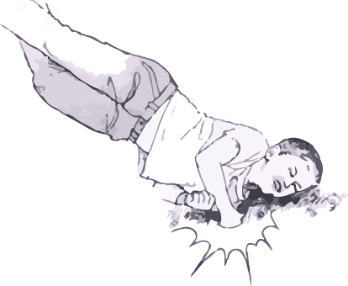
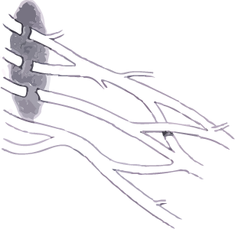
MECHANISM OF INJURY
Fig. 6. Upper brachiaI plexus injuries occur when the head and neck are vioIently moved away from the ipsilateraI shoulder. The shoulder is forced downward wheras the head is forced to the opposite side. The result is a stretch. avulsion. or rupture of the upper roots (C5. C6. C7). with preservation of the lower roots (C8. T1)
www.msdlatinamerica.com/ebooks/HandSurgery/sid744608.html

Slide 23
Clinical features
High degree of suspicion in injury to shoulder girdle, first rib and axillary artery
Median, ulnar and radial nerves can be evaluated by examining finger and wrist motion
Elbow flexion and extension can be used to examine musculocutaneous nerve and high radial nerve function
Injury to posterior cord may affect deltoid function and muscles innervated by radial nerves

Slide 24
Latissimus dorsi innervated by thoracodorsal nerve is palpated posterior axillary fold
Medial and lateral pectoral nerves are branches of medial and lateral cord respectively and supply sternal and clavicular head of pectoralis major respectively
Supra scapular nerve function shoulder extension, rotation and elevation
Look for Horner syndrome, injury to long thoracic nerve and dorsal scapular nerve to differentiate between pre and post ganglionic lesion

Slide 25
Assess spinal accessory nerve
Active passive range of motion
Rule out cord injury
Tinel’s sign
Vascular examination
Fractures

Slide 26
PREOPERATIVE PLANNING
Box 1. Preoperative planning priorities for brachial plexus injury surgery
Review clinical examinations
Scrutinize electrodiagnostic studies
Review CT myelography/imaging
Assemble operative team, plan for intraoperative electrodiagnostic studies
Plan a preoperative conference, including priorities and contingency plans
Prepare patient’s expectations

Slide 27
IMAGING
Radiography- cervical spine views
- shoulder view- AP and
axillary
-X- Ray chest
CT myelography- gold standard for root injury, done at 3 to 4 weeks to see for pseudo meningocoele formation
MRI shows whole of brachial plexus, cord injury and neuroma formation

Slide 28
ELECTRODIAGNOSTIC STUDIES
Can help confirm a diagnosis
Localize lesions
Define severity of axon loss and completeness of lesion
Serve as an important adjunct to thorough history, physical exam and imaging study

Slide 29
For closed injuries EMG and NCV can best be performed 3 to 4 weeks after the injury because wallerian degeneration will occur by this time

Slide 30
EMG
Denervation changes(fibrillation potentials) can be seen in proximal muscles 10 to 14 days and 3to6 weeks post injury in most distal muscles
Reduced MUP(motor unit potential) recruitment can be shown immediately after weakness from LMN injury
Presence of active motor units with voluntary effort and few fibrillations at rest has good prognosis
Can help in distinguishing preganglionic from postganglionic lesions

Slide 31
NCS
In post traumatic BPI the amplitude of compound muscle action potentials (CMAP) are generally low
SNAP important in localizing a lesion as pre or postganglionic

Slide 32
INTRA OP TESTING
NAP (nerve action potential
SEP (somatosensory evoked potential)
CMAP (compound muscle action potential)

Slide 33
Management
Proximal rupture, distal avulsion 60%
Complete 5 level injury 50% Five level avulsion 30%
Supraclavicular 70-75% Upper trunk 35% C4-T1 avulsion 10%
C6-C8avulsion 8%
C8/T1 isolated 3%
Whole limb injury 45%
Intraclavicular 25-33% Single/combined cord injury 30%
Isolated peripheral nerve injury 25%
Fig. I. Distribution of location and iv of hrachical plesus injuries.

Slide 34
Management
15% of supraclavicular injuries have concomitant segmental injuries at or below the clavicle where the peripheral nerve branch from the plexus
Musculocutaneous, axillary and suprascapular nerves are particularly vulnerable to traction injury because of soft tissue tethering near their origin

Slide 35
Infraclavicular injuries constitute 25- 33% of BPI usually occur at cords or peripheral nerves and usually are incomplete
Usually caused by shoulder fracture or dislocation
5- 25% of infraclavicular injuries are associated with axillary artery injury
Penetrating injuries are usually infraclavicular

Slide 36
Timing of intervention
A - acute exploration
concomitant vascular injury
open injury by sharp laceration
crush or contaminated wound
B - early exploration (1- 2 weeks)
unequivocal complete C5- T1 avulsion injuries
C - delayed exploration > 3 months
recommended for complete injuries with no recovery by clinical examination or EMG at 12 weeks post injury
candidates showing distal recovery without regaining clinical or electrical evidence of proximal muscle function

Slide 37
Prioritization
Clearly understand the anatomy of injured plexus
What is available for nerve transfer
Function priority- elbow flexion is the most important to restore followed by abduction, external rotation and scapular stabilization
Long thoracic nerve should be performed whenever possible
Radial nerve motor function can often be restored with triceps function more likely to return

Slide 38
Surgical options
Neurolysis
Nerve repair
Nerve graft
Nerve transfer or neurotization
Functional free muscle transfer

Slide 39
Neurolysis
Effective only if scar tissue seen around nerve or inside epineurium, preventing recovery or causing pain
Pre and post neurolysis direct nerve stimulation is mandatory to evaluate improvement in nerve conduction

Slide 40
Nerve repair
Used in sharp transection with excellent fascicular pattern and minimal scar

Slide 41
Nerve graft
Indicated for well defined nerve ends without segmental injuries
Intraoperatively a good fascicular pattern should be seen after the neuroma is excised
Possible sources: sural, brachial cutaneous nerve, radial sensory and possibly ulnar nerve
Before implantation graft orientation should be reversed to minimize axonal branch loss
Surgical technique is considered the most important factor in nerve graft

Slide 42
Neurotization
A- intraplexal
B- extraplexal
Plexoplexal options are undamaged roots
Other options include medial pectoral nerves and medial cord ulnar nerve
Extraplexal options- spinal accessory, intercostal, phrenic and motor branch of deep cervical plexus

Slide 43
For upper arm type avulsion, a reliable neurotization strategy has included phrenic-suprascapular nerve transfer and spinal accessory nerve (with an interpositional nerve graft) to musculocutaneous nerve.

Slide 44
For complete avulsion injury, a strategy of multiple neurotizations using spinal accessory, phrenic and contralateral C7 nerves provides a patient with a framework to obtain hook grip.

Slide 45
OBERLIN TECHNIQUE For upper trunk injury with intact lower trunk- 1 to 2 fascicles of ulnar nerve are anastomosed to biceps
Contra lateral C7 is used in pan brachial plexopathy with multiple avulsions and limited donor possibility
Contra lateral C7 root can be extended by means of vascularised ulnar nerve graft in patient with C8 T1 avulsion and median nerve is the most frequent recipient
Another option is transferring nerve to long head of triceps to anterior branch of axillary nerve

Slide 46
Realistic targets to reinnervation
Spinal accessory to suprascapular or musculocutaneous
Phrenic to axillary nerve
Intercostal to musculocutaneous long thoracic, radial and median nerve
Long head of triceps nerve to anterior branch of axillary nerve

Slide 47
Functioning free muscle transfer
Usually gracillis is used- single or double gracillis transfer

Slide 48
PROGNOSIS
Highly dependent on pattern of injury
Complete C4 to T1 injuries are considered most severe and virtually irreparable
Avulsion injuries from C5 toT1 amenable to restoration of shoulder and elbow function only
Ideal candidate for surgery are patients with proximal rupture or avulsion and sparing of lower trunk

Slide 49
AIIMS STUDY
Since 1995 to2002 , 505 patients were studied for functional and occupational outcome after surgery for BPI
In India BPI is most common due to RTA with Rt side involved in 2/3
40% cases have pan BPI
85% of cable graft yielded improvement in motor power compared 68% in neurotized nerve and 66% in patients undergoing neurolysis

Slide 50
Most effective donor nerve for musculocutaneous neurotization was medial pectoral nerve (63.6%) patient improved
Accessory nerve was most effective for neurotization of suprascapular nerve (100%)
Thoracodorsal axillary neurotization gave (66.7% improvement)
50% patients either remained unemployed or had to change there jobs

Slide 51
Thank you

